Slide 1
Error Detection
Error are likely to occur even when there is a sufficient SNR to provide a low bit error rate
To control error and improve the reliability of a communication line, first we must be able to detect the errors
CRC one of the best techniques to detect the error

Slide 2
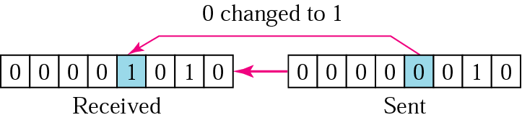
Types of Error
Single Bit Error: In a single-bit error, only one bit in the data unit has changed

Slide 3
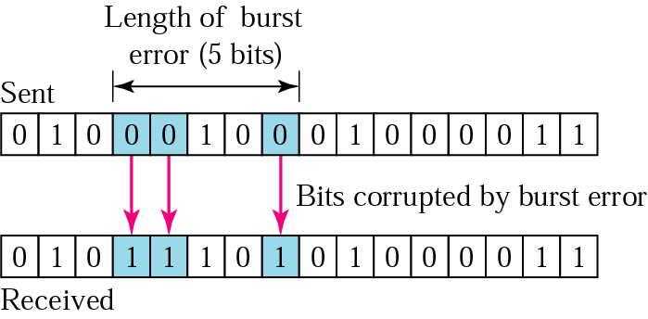
Burst Error
A burst error means that 2 or more bits in the data unit have changed

Slide 4
Detection
Redundancy: adding extra bits for detecting errors at the destination.
- Parity Check: a parity bit is added to every data unit so that the total number of 1s is even (or odd for odd-parity).
- Cyclic Redundancy Check (CRC)
Checksum

Slide 5
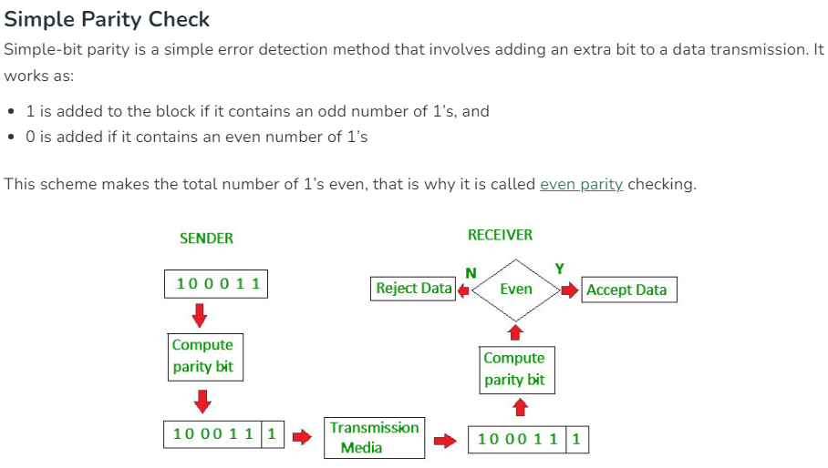

Slide 6
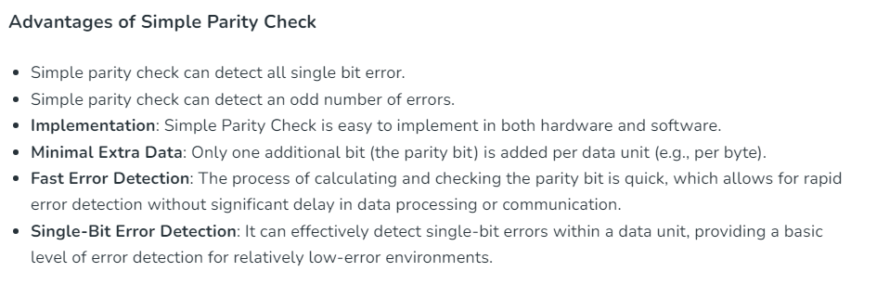

Slide 7
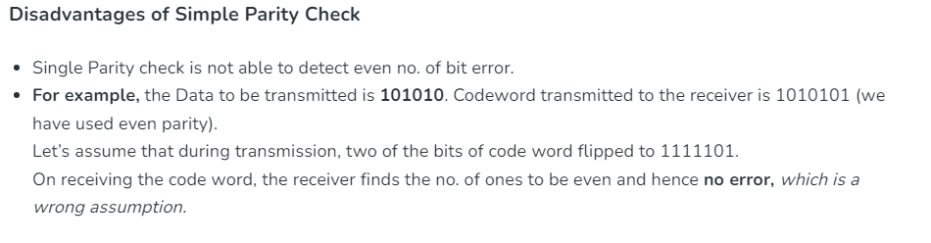

Slide 8
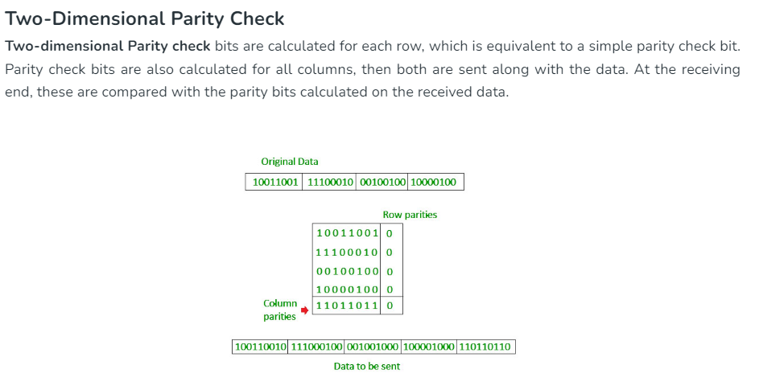

Slide 9
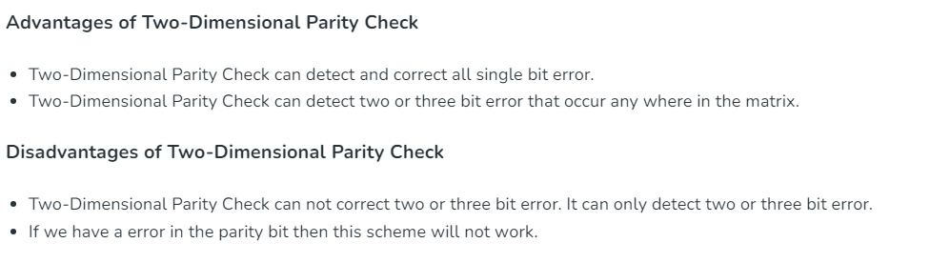

Slide 10
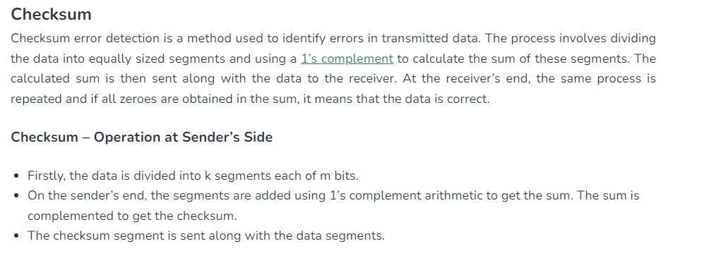

Slide 11
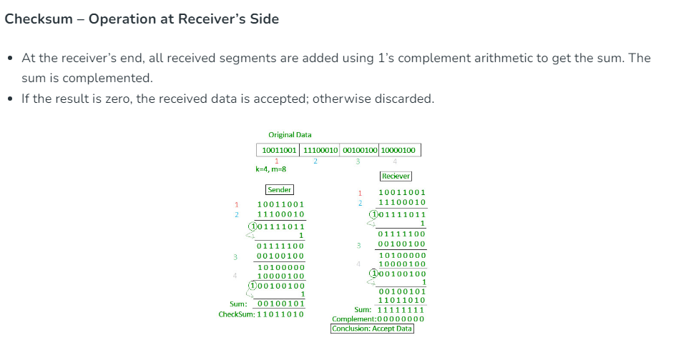

Slide 12


